Slide 1

HPE Morpheus Plugin Program: Overview
Neil van Rensburg
April 4th, 2025

Slide 2
Confidential Disclosure Agreement
The information contained in this presentation is considered Confidential Information of Hewlett Packard Enterprise (HPE) and is subject to the Confidentiality terms and conditions in your HPE vendor or partner agreement
This presentation may be shared with HPE Authorized Service Providers and Channel Partners in hard-copy or electronic format for their internal training purposes only
This presentation is NOT to be used as a ‘leave behind’ for HPE external customers
The information in the presentation may only be shared verbally with HPE external customers who are under CDA and should NOT be used for commercial purposes
Do not remove any classification labels, warnings or disclaimers on any slide or modify this presentation to change the classification level
Do not remove this slide from the presentation
HPE does not warrant or represent that it will introduce any product to which the information relates
The information contained herein is subject to change without notice
HPE makes no warranties regarding the accuracy of this information
The only warranties for HPE products and services are set forth in the express warranty statements accompanying such products and services
Nothing herein should be construed as constituting an additional warranty
HPE shall not be liable for technical or editorial errors or omissions contained herein
Strict adherence to the HPE Standards of Business Conduct regarding this classification level is critical

Slide 3
Table of Contents
Introduction
Plugin Program Focus Areas
Program Admin
Plugin Enablement
…

Slide 4
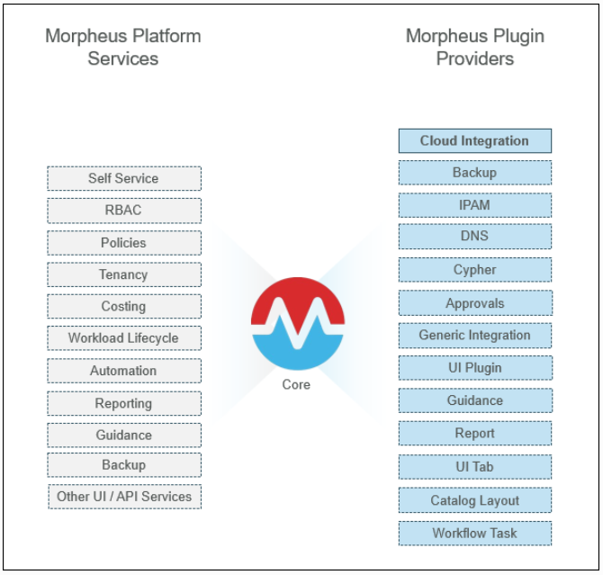
Introduction
Morpheus plugins extend platform services to 3rd party products. For example, the Morpheus AWS Plugin extends provisioning services onto the AWS cloud. Through the Morpheus Plugin Core, several types of plugin integrations, called Providers, are exposed through a common set of well-defined interfaces. A Morpheus plugin can contain a set of multiple providers to bring about the desired combination of integrations. For example, adding an IPAM provider class to a cloud plugin, will result in one plugin containing both cloud and IPAM integration functionality.
Plugins are mostly written in Groovy, which is a dynamically typed programming language that can be mixed with Java syntax, and compiles to the Java runtime. The plugin build pipeline leverages Gradle as the build tooling.

Slide 5
HPE Morpheus Plugin Program Focus Areas
Plugins in Circulation
Intro calls
How-To workshops
Cadence calls
Question & Issue follow-up
Support / Eng. Buffer
Priority Status List
Program Admin
Demo & workshop schedule
NDAs & Alliance agreements
NFRs license allocation
Compatibility Matrices
(NutanixReady)
Plugin Enablement
How-to guides
UI / Method correlation
Workshop material
Videos
Requirements docs

Slide 6
Plugins In Circulation
Intro calls
Typically, a customer needs to understand what is involved in building a particular integration or UI component:
  What skills are required?
  Where do I find resources?
  How are plugins built, compiled and deployed?
  Who maintains the plugin and how?
  What are the options to publish the plugin?
  How long does it take to build an X plugin?
How-To workshops
Following on plugin introduction, customers typically need us to take their technical resources through a getting started demo:
  Preparing a local development environment
  Creating a code project
  Navigate the classes and methods to be populated
  Compiling, deploying and testing plugin code
Cadence calls
As development progresses, Plugin Program Management checks in via mail or weekly calls to understand the status and development progress.
Question & Issue follow-up
Plugin Program management deals with for questions that come up regarding specific use cases, correlating UI functionality to code points in the projects
  Assist with explanations, demos and sample code
  Follow up with engineering to address unanswered/unknown questions
  Follow up with program management on bugs or missing functionality
Priority Status List
  Maintain a list of plugins being developed by engineering and what the priorities and expected dates are
  Track bug fix and expected feature dates for customer feedback
  Track customer plugins currently supported through the process
Plugin Publication
  Provide list of requirements for publication on share.morpheusdata.com.
  Check criteria (e.g., LICENSE file)
  Liaise with engineering to get the plugin publish and linked to the resources (site, documentation, code repo)

Slide 7
Program Admin
Demo & Workshop Schedule
Account Managers and Sales Engineers often field queries around Morpheus integration capability. Often, plugins address integration needs that automation workflows and existing integrations cannot.
In these cases, sales and account representatives would reach and schedule introductory sessions to talk about integration needs, plugin capability and plugin development methodology.
NDAs & Customer/Partner Agreements
Before the Plugin Program Representative engages with a potential customer or partner, a general NDA will be in place. Some customers require additional NDAs to cover their legal requirements.
By using Morpheus, customers and partners agree to the general EULA, which in turn, references the plugin core license. The current Morpheus EULA and Plugin Source License (PSL) can be viewed here:
https://morpheusdata.com/eula/
https://morpheusdata.com/plugin-source-license/
With the acquisition and the Morpheus/VME split, these terms will be revisited and adjusted according to HPE policy.
NFR License Allocation
The current community license allows developers and testers a 25 Workload Element license (WLE). Often with plugins, these aren’t sufficient and an NFR (Not For Resale) license needs to be issued. This is done in tandem with Legal.
It seems probable that the WLE license model will be replaced with core-based licenses in future. This potentially creates additional overhead to keep program engagements current.
Alliances and Compatibility Matrices
Currently, Plugin Program management works with NutanixReady to keep compatibility on major product versions verified. Nutanix compatibility can be viewed here:
https://portal.nutanix.com/page/documents/compatibility-interoperability-matrix/software?partnerName=Morpheus%20Data&solutionType=all&componentVersion=all&hypervisor=all&validationType=all
TBD: Program management to determine whether other alliance partners should be approached for this.

Slide 8
Plugin Enablement
How-To Guides
Currently, how-to guides are planned for each common customer use case plugin type:
  Report, dashboard, cloud, IPAM, backup, cypher…
  Cloud plugin guide is in alpha, based on proxmox integration
  Report plugin guide in progress based on user provisioning count
  Development environment setup guide content ready for review
Workshop Material
In 2024, an experimental workshop was delivered to a limited audience, based on the how-to guide for cloud plugins. We are currently investigating the best format to deliver these for major plugin providers.
General documentation
As development progresses, Plugin Program Management checks in via mail or weekly calls to understand the status and development progress.
Requirements Guide
Due to the number of requests for assistance on customer cloud plugin development initiatives, it became clear that a concise to-do list is needed for minimum functionality. This serves as input for:
  Defining MVP functionality
  SOW planning and timeline estimations
  Verifying customer requirements against actual functionality
UI / Method Mapping
A recurring question popping up with several different plugins: “Which code method correlates to which action in the UI?”
Built into the Requirements Guide is a rundown of primary methods to make the cloud plugin function. This should become its own set of guides.
General Documentation
Current plugin documentation can be found at https://developer.morpheusdata.com/docs. We are working on step-by-step documentation for:
  Getting started, development environment, building, compiling, deploying.
  Plugin core mechanisms & examples: contexts, services, data services, http helpers, routing etc.
Video Content
Currently there are 3 plugin related videos on the YouTube channel. These need to be expanded to domain-specific walkthroughs:
  https://www.youtube.com/watch?v=HLkQmPOXfS0&t=12s
  https://www.youtube.com/watch?v=59qWW9dYHtY&t=861s
  https://www.youtube.com/watch?v=_P-38dqBkIA&t=2158s
ILT Filler Chapters
At times, ILT classes may finish early, depending on the group. Optional content chapters may be used to fill up the time. There has been much interest in training material for plugins, so, content chapters on dashboard and tab plugins would be a good idea.

